Slide 1
CV project
The presentation was prepared by:
Smakhan Bizhan

Slide 2
About me
I am studying in the specialty: automation and control
I started to get interested in programming in the 2nd year at the University.
Knowledge: Java Core

Slide 3
Project technology
Back-end: Spring Framework
Front-end: Angular
Data base: PostgreSQL

Slide 4
Back-end PostgreSQL
Front-end
In the backend, I used most of the " get " functions. Each model has its own table, not used hibernate.
4 model – 4 table(not used hibernate)
in the frontend, I used material, cdk, animations.
4 component:
Header
Home
Resume
Project

Slide 5
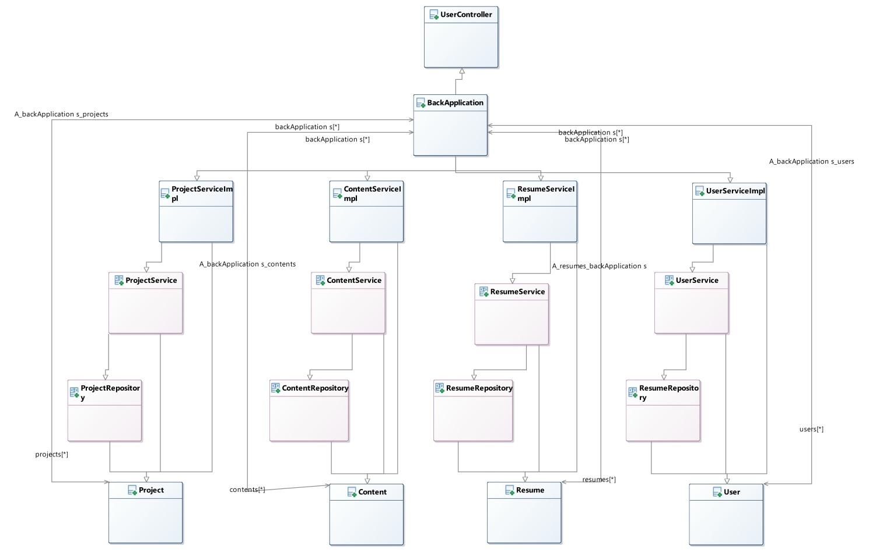
Back-end UML Class diagram

Slide 6
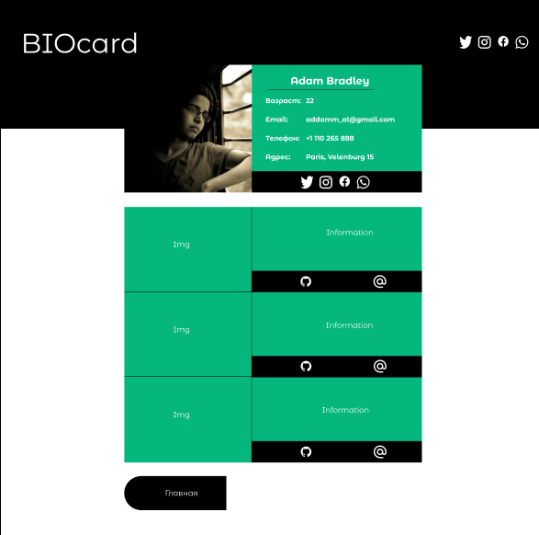
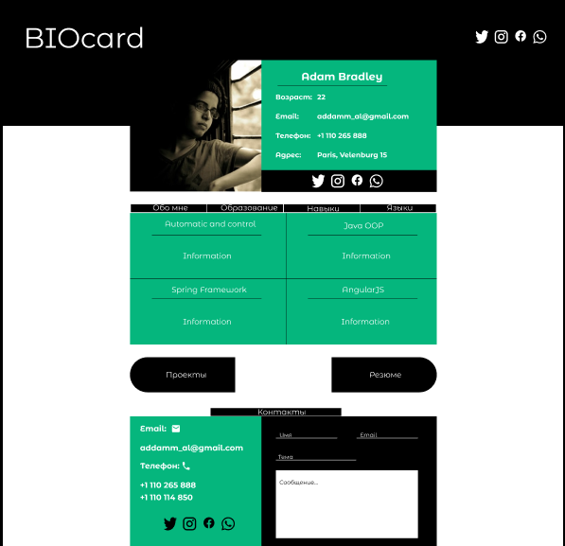
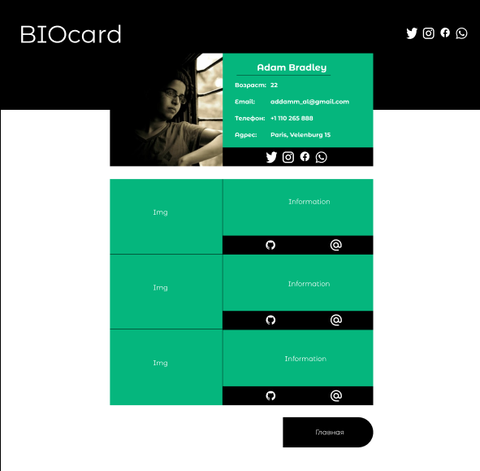
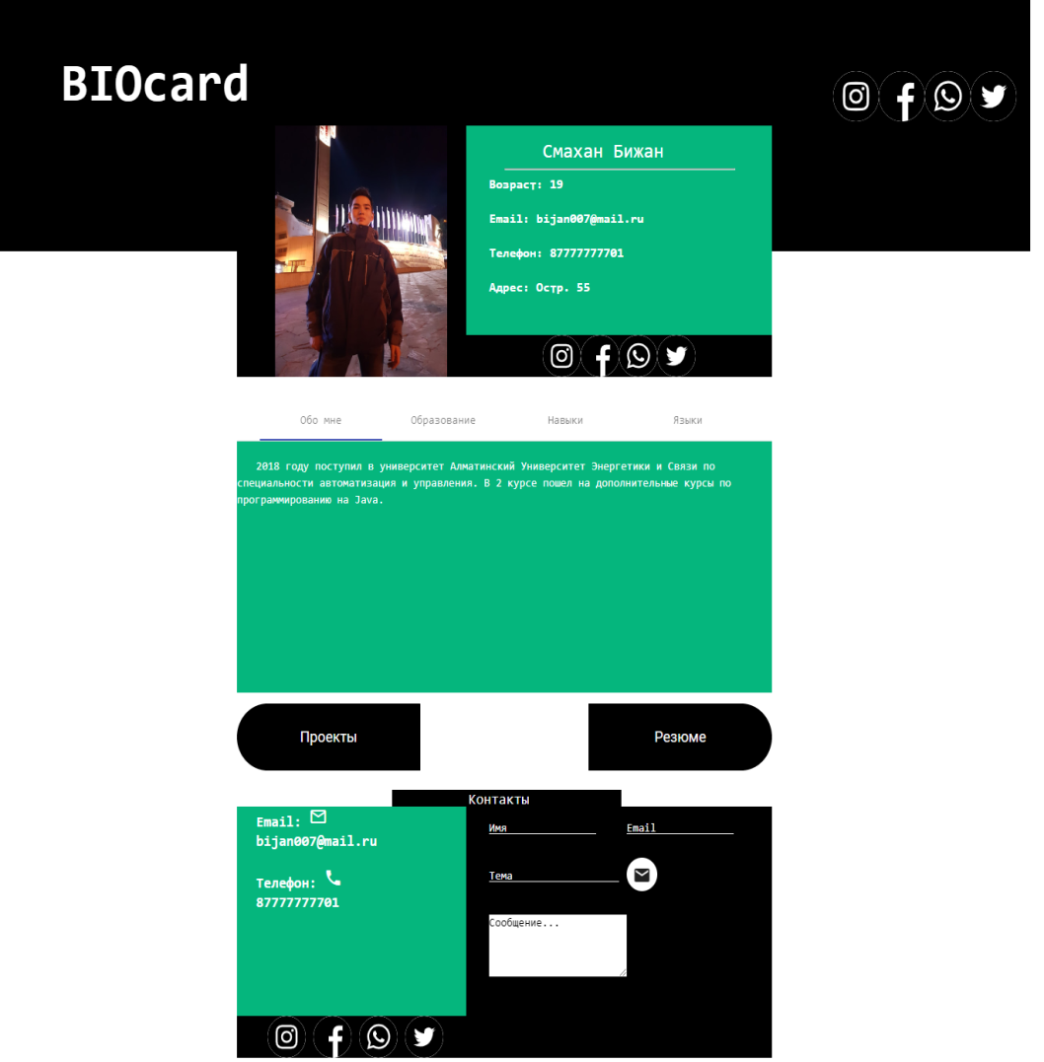
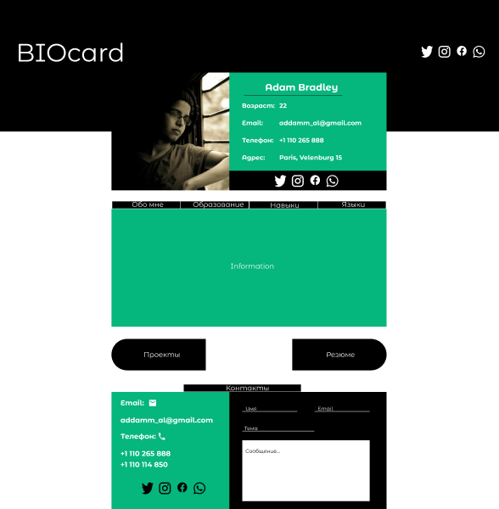
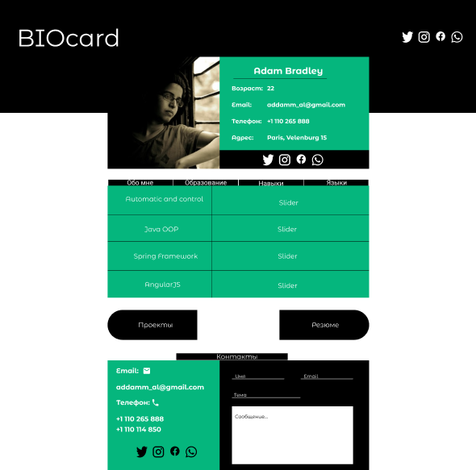
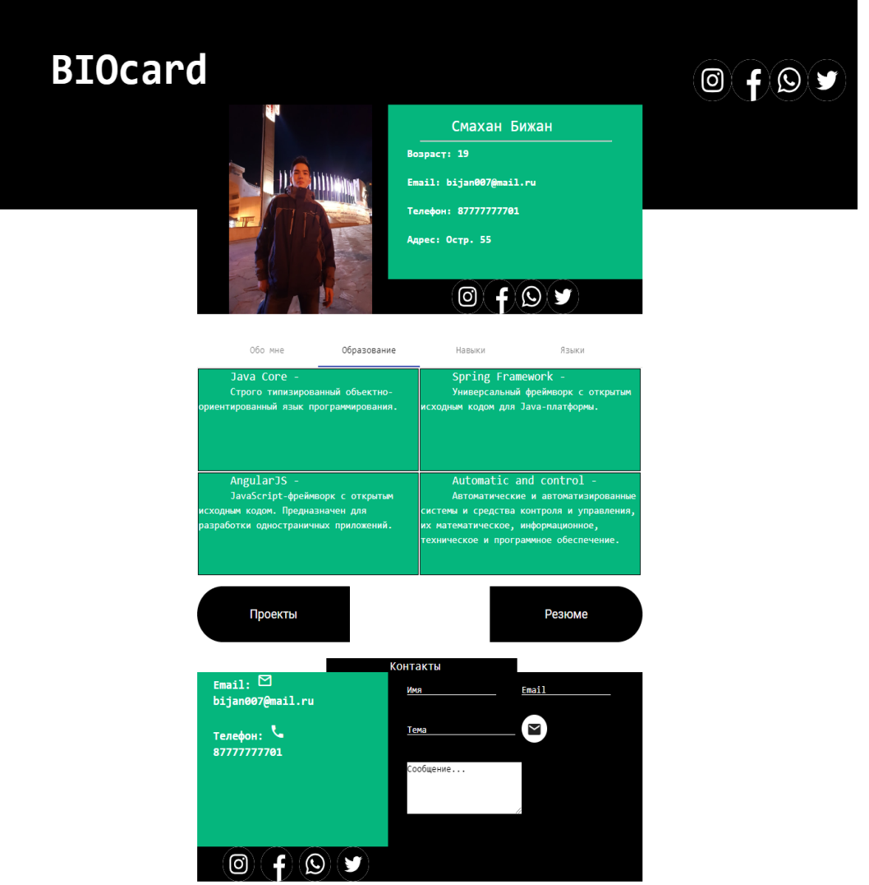


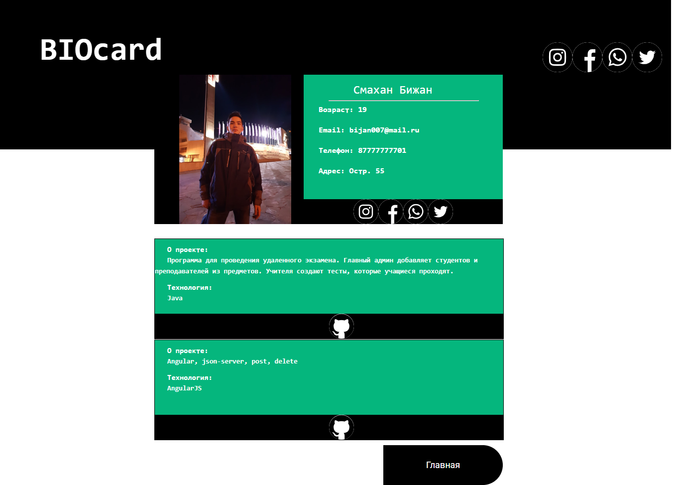
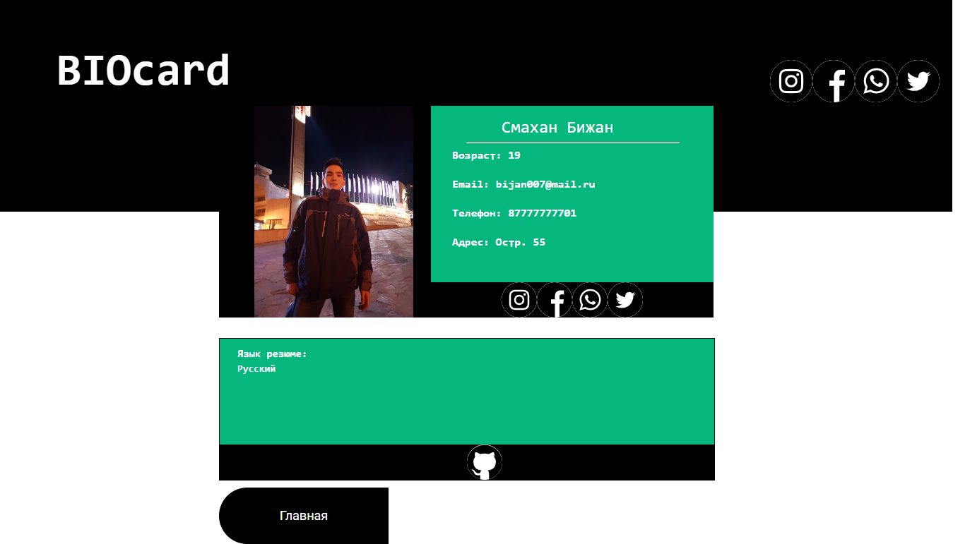
The initial template
Final version

Slide 7
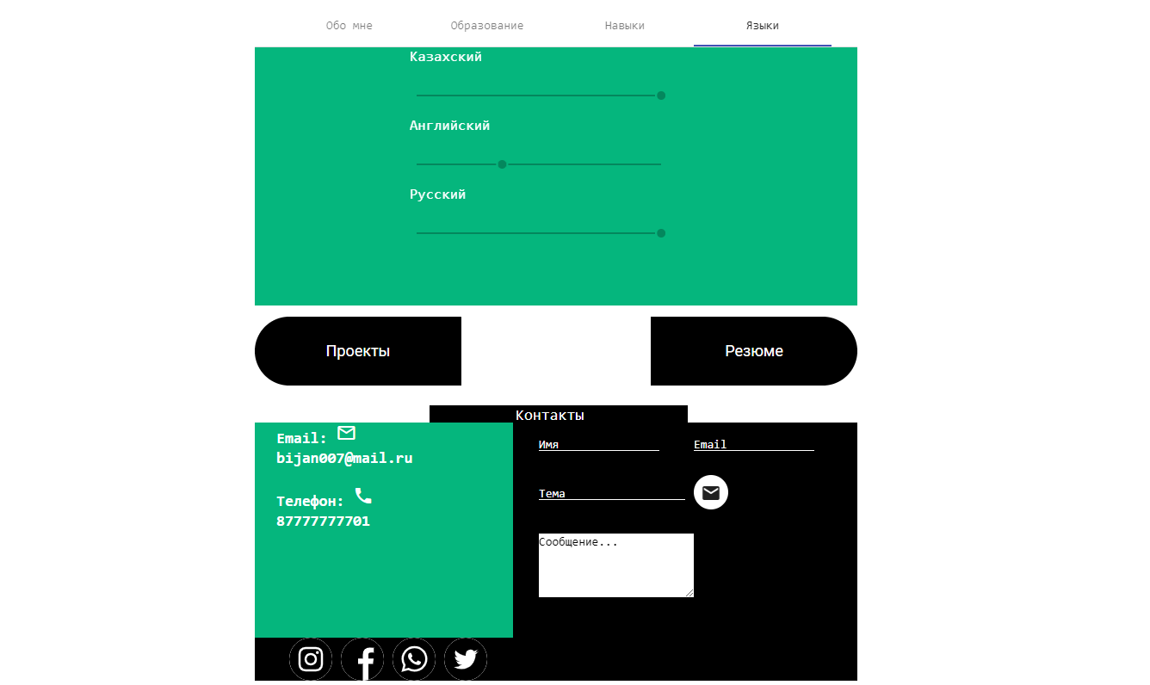
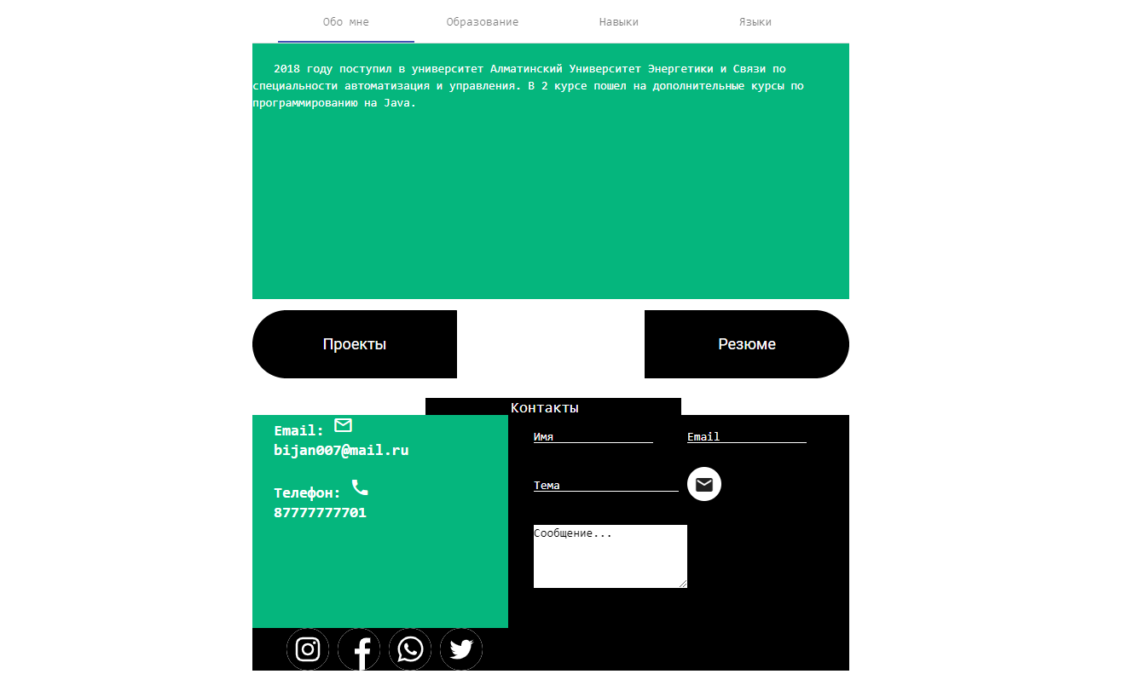
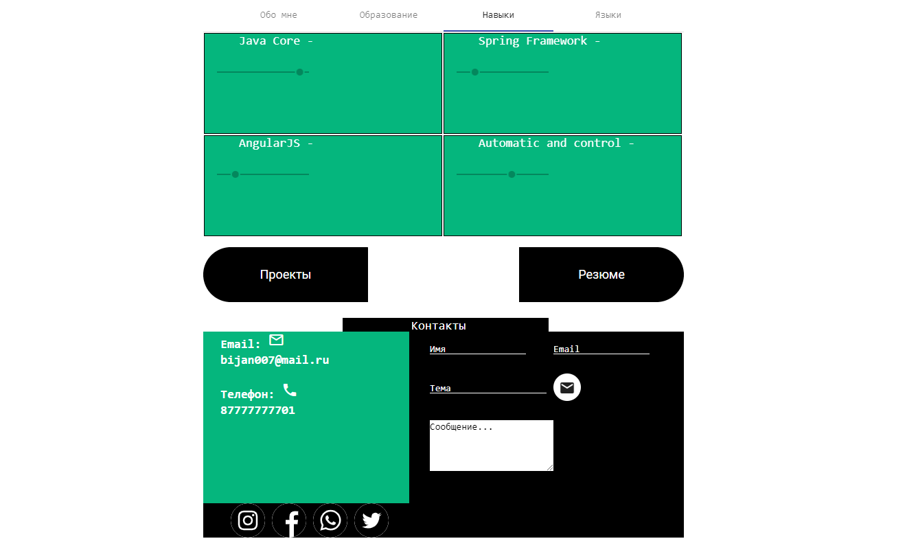
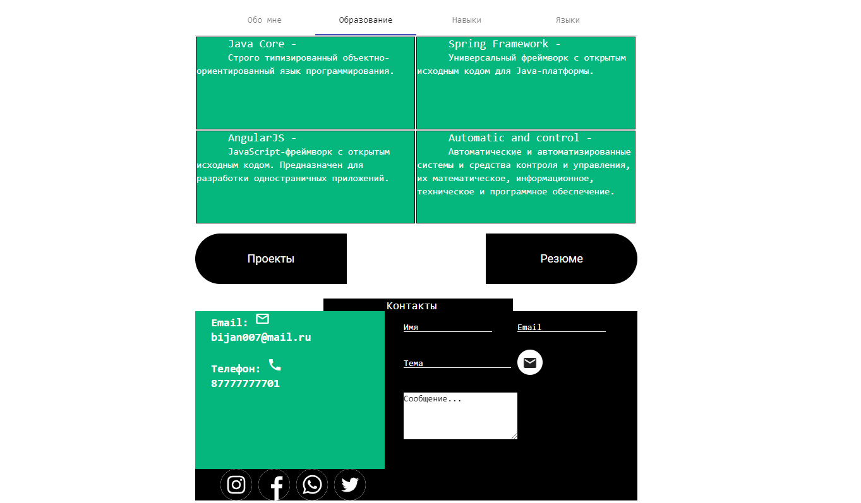
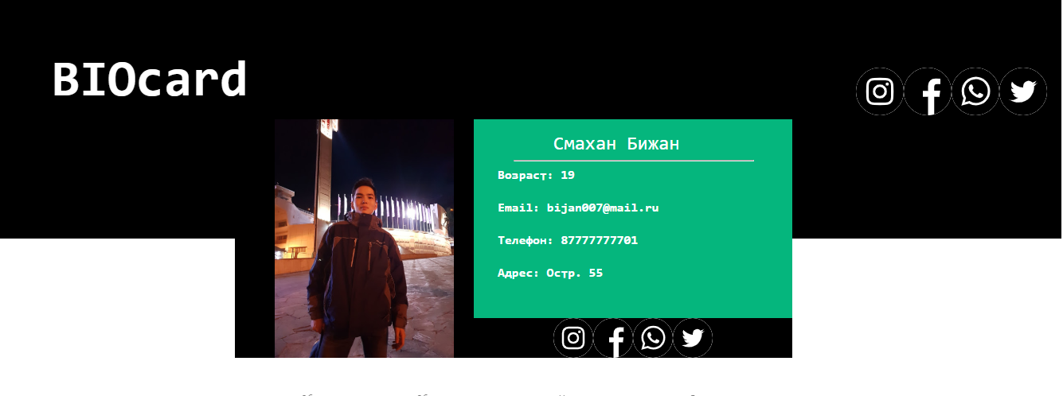
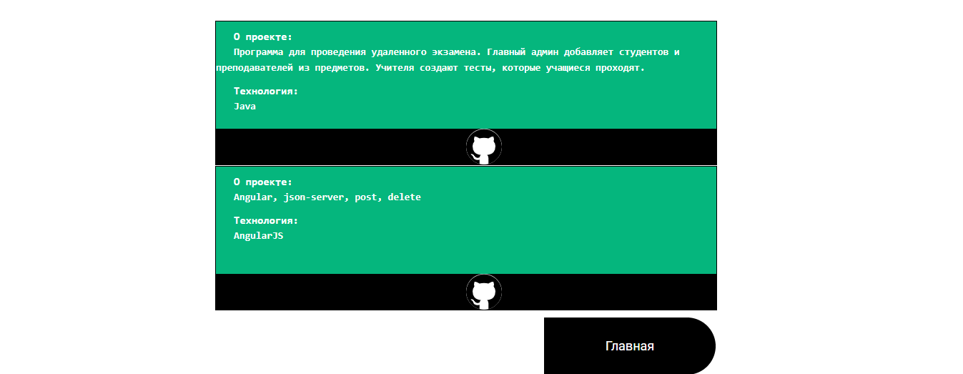

Header
Home
Project
Resume

Slide 8
Final
What I learned in Camp
expanded my knowledge of programming
work with Angular
work with Spring Framework
to combine the Backend and Frontend

